Slide 1
Double Q-Learning
Zhuoyu Wang
COMP 762

Slide 2
Recap
Sarsa
Q-Learning

Slide 3
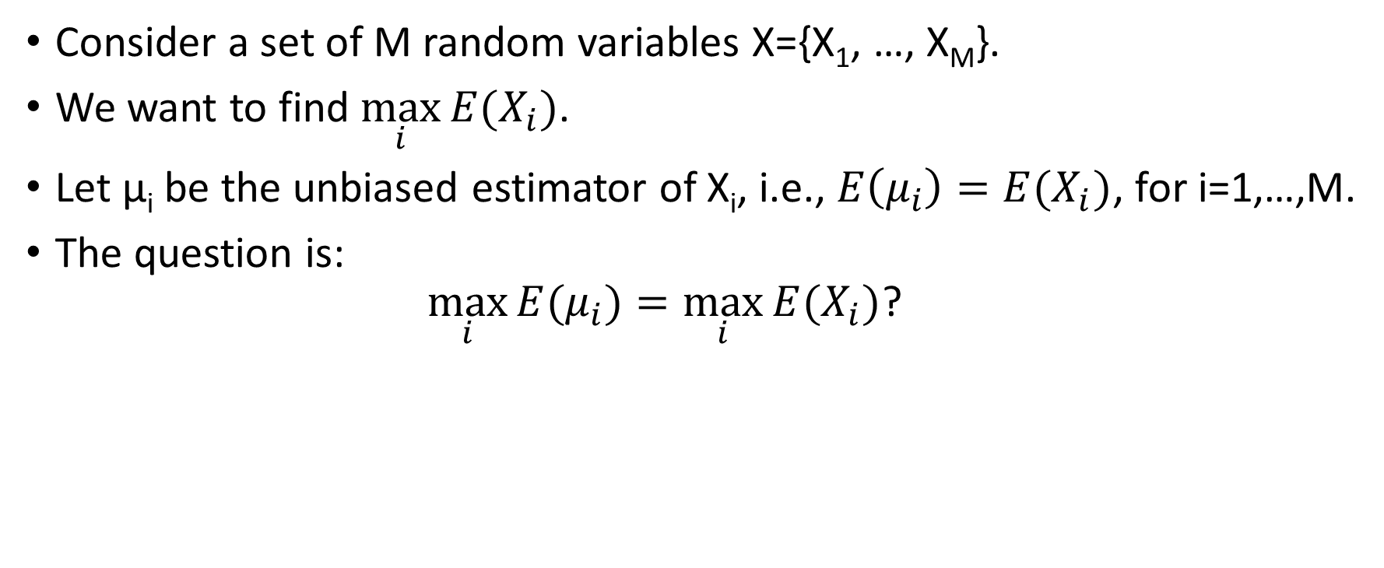
Estimating Maximum Expected Value
Consider a set of M random variables X={X₁, …, X_{M}}.
We want to find $\max_{i}{E(X_{i})}$.
Let μ_{i} be the unbiased estimator of X_{i}, i.e., $E\left(μ_{i}\right)=E(X_{i})$, for i=1,…,M.
The question is: $\max_{i}{E(μ_{i})}=\max_{i}{E(X_{i})}$?

Slide 4
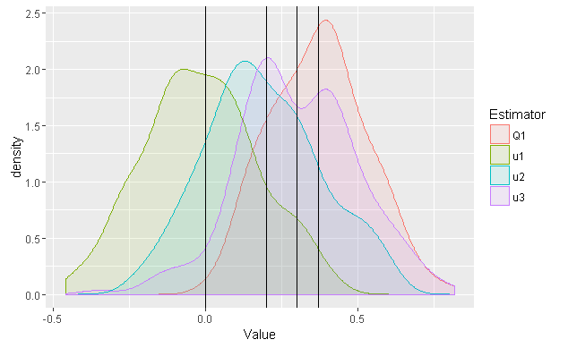

Single estimator (Q1): Overestimation!
Consider 3 random variables:
X₁~Normal(0, 2)
X₂~Normal(0.2, 2)
X₃~Normal(0.3, 2)
$μ_{i}=\frac{1}{100}(X_{i1}+…+X_{i100})$ for each X_{i}.
$Q_{1}=max⁡(μ_{1},μ_{2},μ_{3})$.
Repeat 200 times.

Slide 5
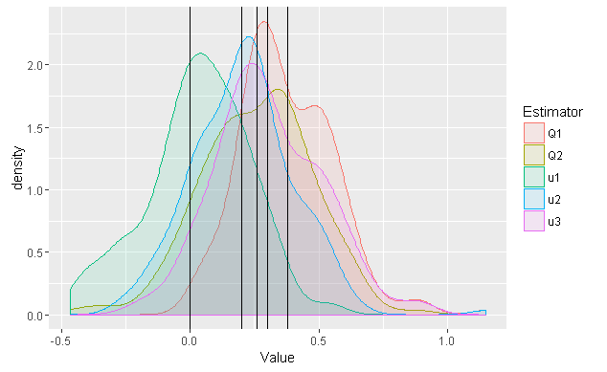

Double Estimator (Q2)
$Q_{1}=max⁡(μ_{1},μ_{2},μ_{3})$.
Assume ${μ_{i∗}=Q}_{1}$.
Instead of using the value of $μ_{i∗}$:
Generate a new $μ_{i∗}$, say $μ_{i∗}^{′}.$
$Q_{2}=μ_{i∗}^{′}=\max_{i}{E(X_{i})}$
Underestimated.
That’s what Lemma 1 says.

Slide 6
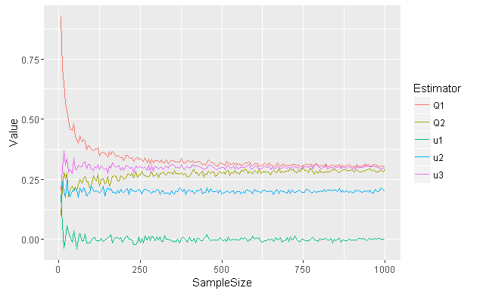
Convergence

